Slide 1
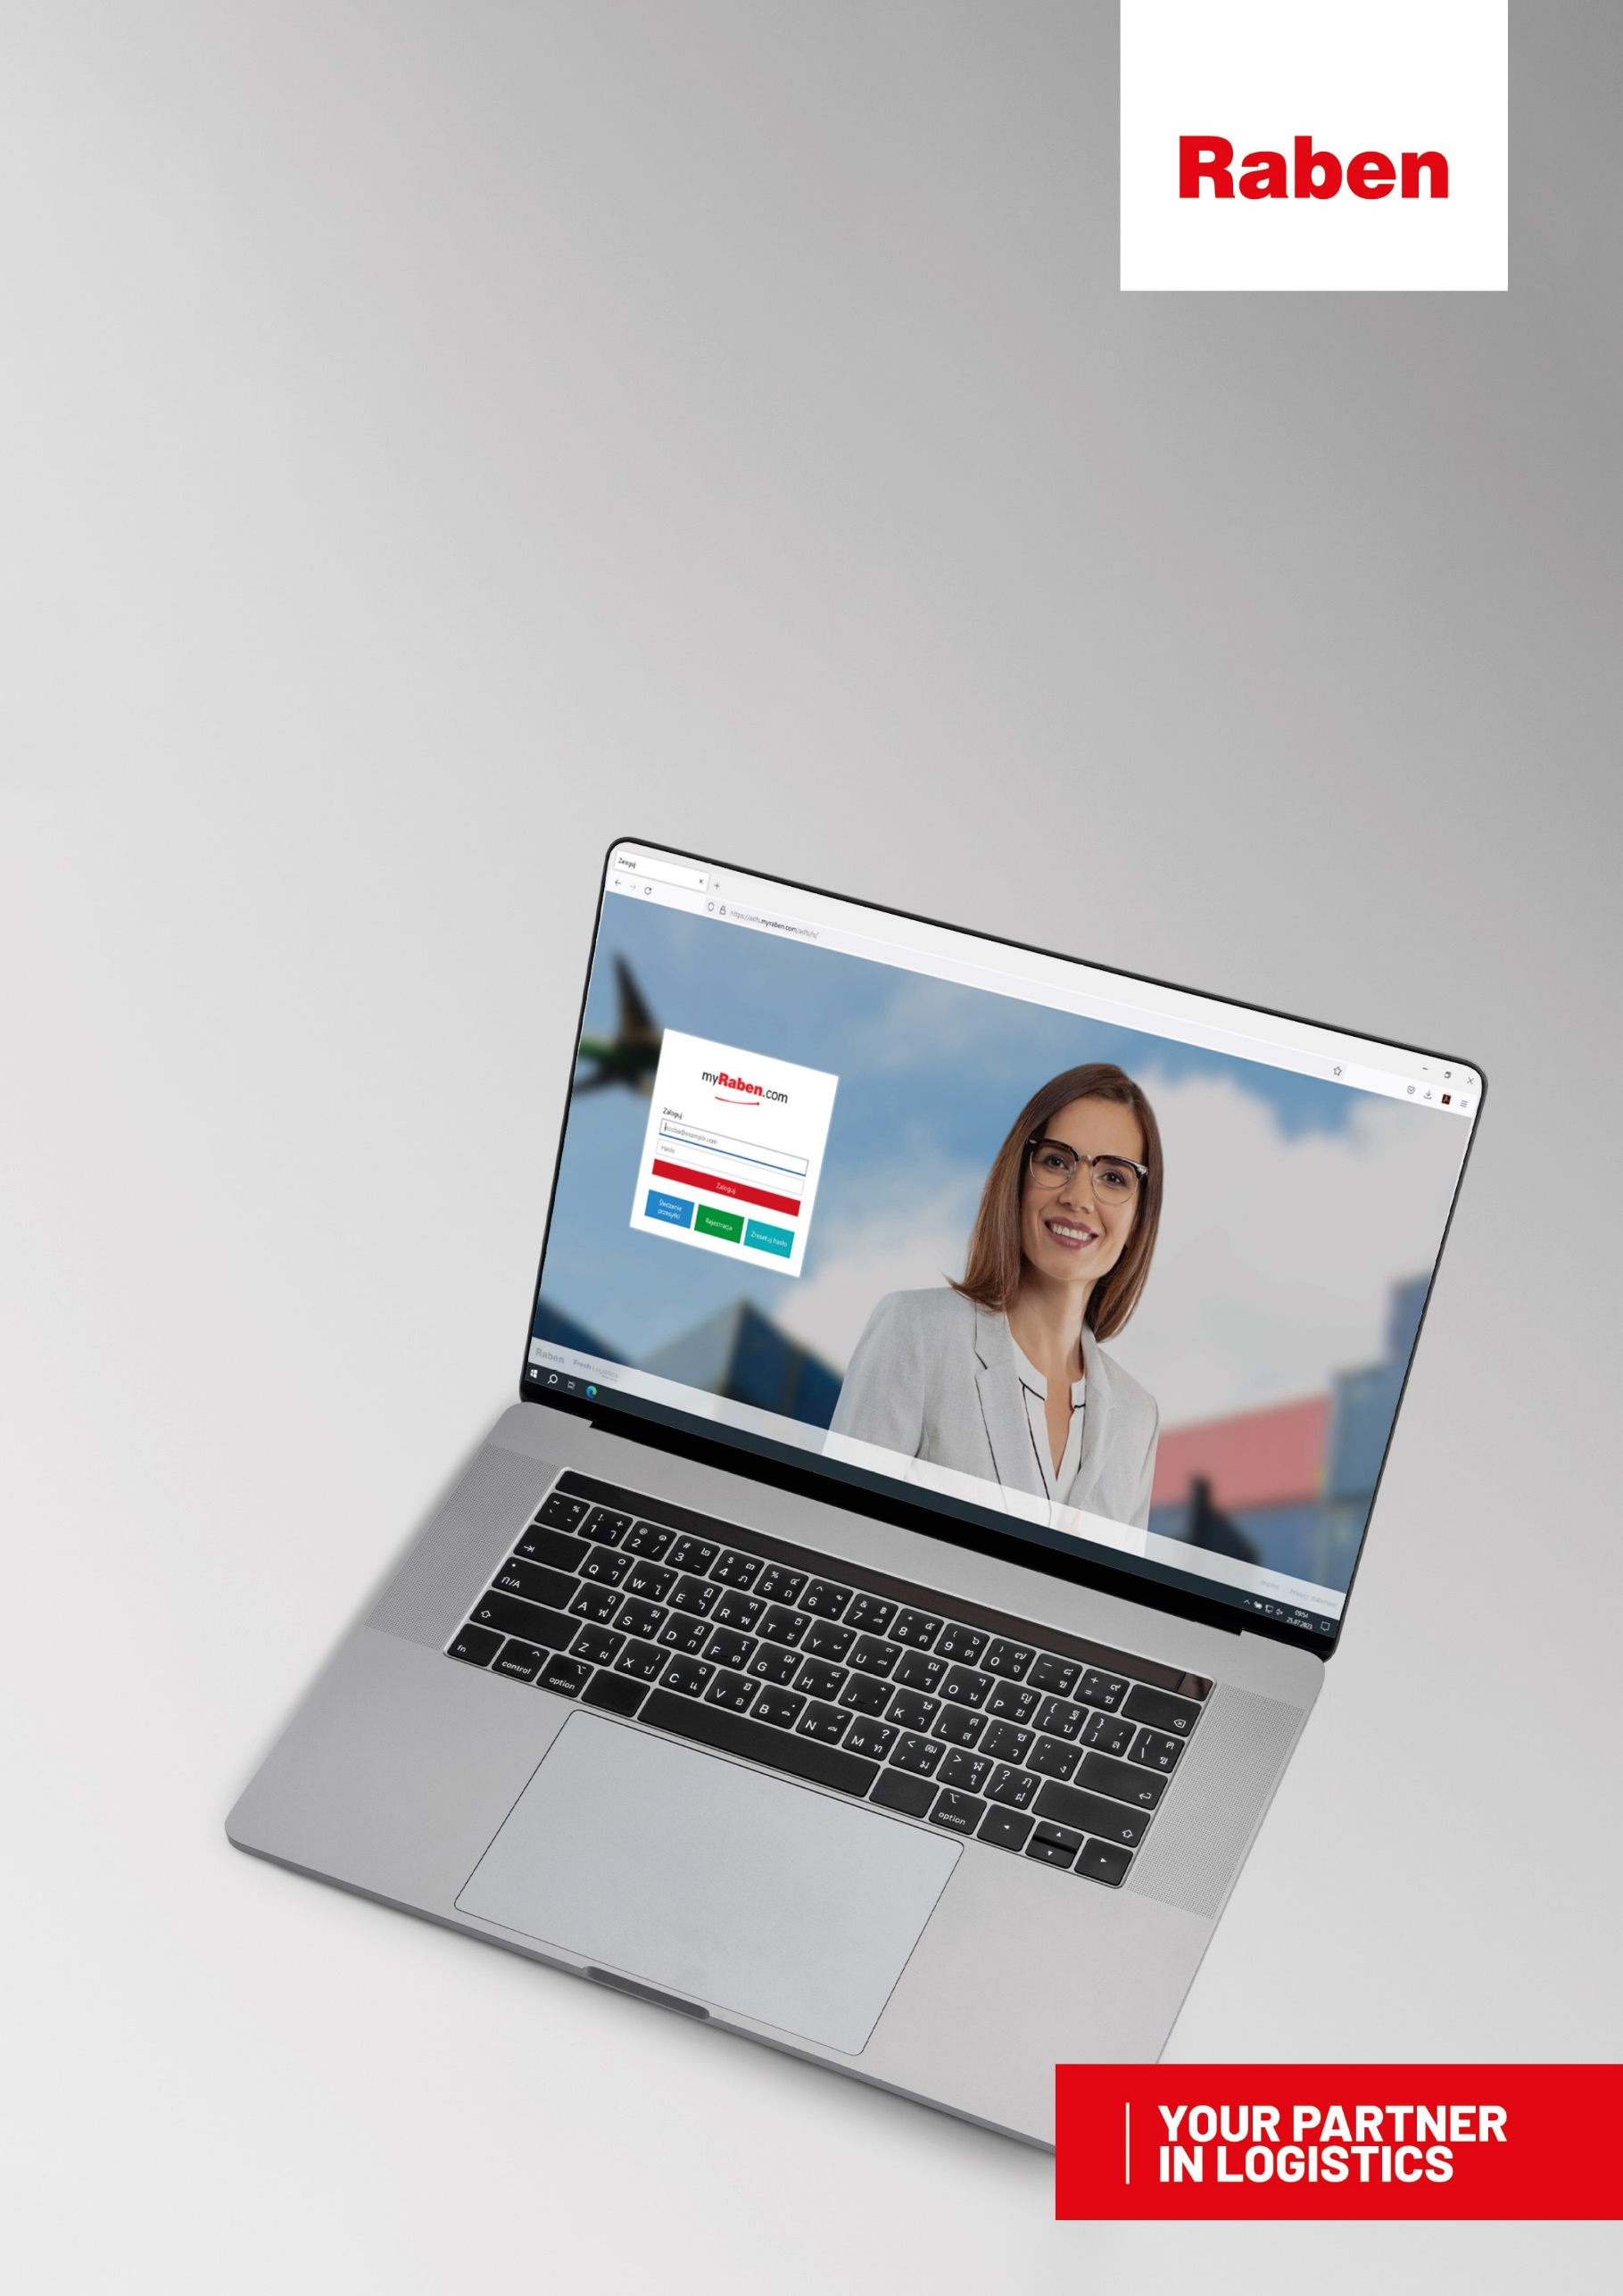
myClaim
FILING AND MONITORING CLAIMS
MANUAL FOR CUSTOMERS

Slide 2
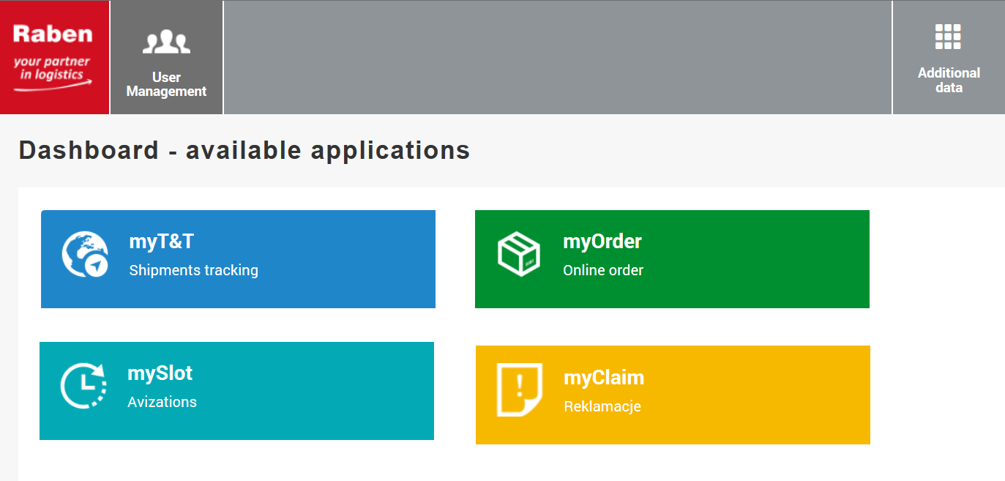
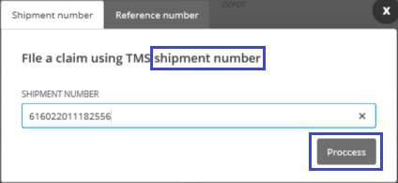
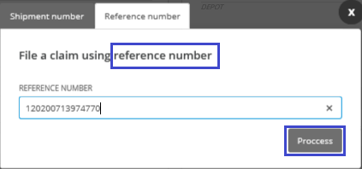
I.
Filing a new transport claim via myClaim
myTrack&Trace
shipments - warehouse orders
documents - invoices
mySlot
- advice in Raben warehouses
myOrder
– placing orders
myClaim
- list of filed claims
Step 1. After going to the myClaim module, select “File a claim”
Step 2. Provide Raben shipment number concerning the reported damage: (15-digit number) or the shipment reference number.
After clicking on the “Process” button, the shipment database will be searched.

Slide 3
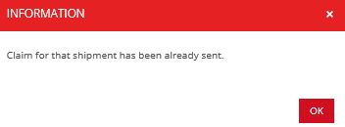
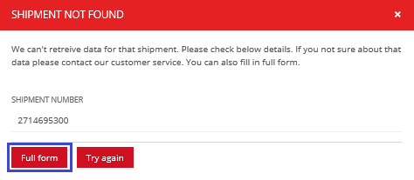
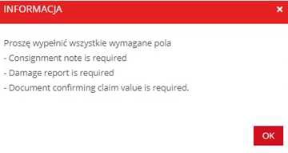
A. If a claim was already filed for the selected shipment - the user will receive a message (see below) and will be redirected to claim details.
B. If the given shipment number is not found by the system, a message (see below) will appear. If, after checking the number again, the user is certain of its correctness, it is still possible to file a claim - however, it will be necessary to provide its full details.
C. If the shipment number provided by the user is in Raben database, they will be redirected to the claim form.
If there are transport documents in Raben system, they will be attached to the claim - there is no need for the user who files the claim to attach them.
Step 4. The claim form must be completed.
After providing all the data and attaching all necessary documents press Send –
If some documents necessary for handling the claim are missing, the user will receive a message about the need to submit them.

Slide 4
II.
Filing a new warehouse claim - applies to warehouse logistics customers.
Step 1. After going to the myClaim module, select “damage report”.
It contains damage reports prepared by the logistics warehouse for incidents which occurred in the warehouse of the warehouse logistics customer.
They are the basis for filing a claim.
Step 2. From the available reports, select/search the appropriate damage report from the list using the available filters and use the "File a complaint" button
- you will be redirected to the claim form.
Damage report to which the claim was filed
- visible claim number
Step 3. The claim form must be completed.
After providing all the data and attaching all necessary documents press Send –
If there are transport documents in Raben system, they will be attached to the claim - there is no need for the user who files the claim to attach them.
If some documents necessary for handling the claim are missing – the user will receive a message about the need to submit them.

Slide 5
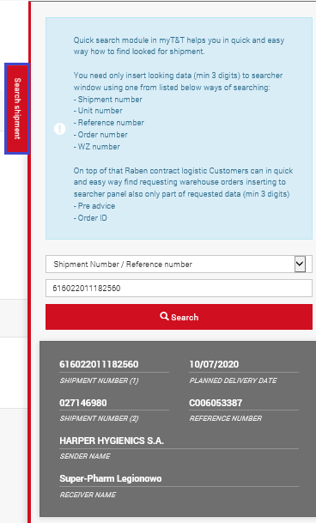
III.
Filing a new claim via myTrack&Trace.
shipments
documents
myTrack&Trace
mySlot
– advice in Raben warehouses
myOrder
– placing orders
myClaim
- list of filed claims
warehouse orders
invoices
Step 1. Find the shipment the claim refers to in myTrack&Trace.
ATTENTION! – available time range is the last 125 days (approx. 4 months). To do that, use:
Quick Search
Quick Search
In the category - Shipment No.- enter:
Shipment number (1);
Shipment number (2);
Reference number;

Slide 6
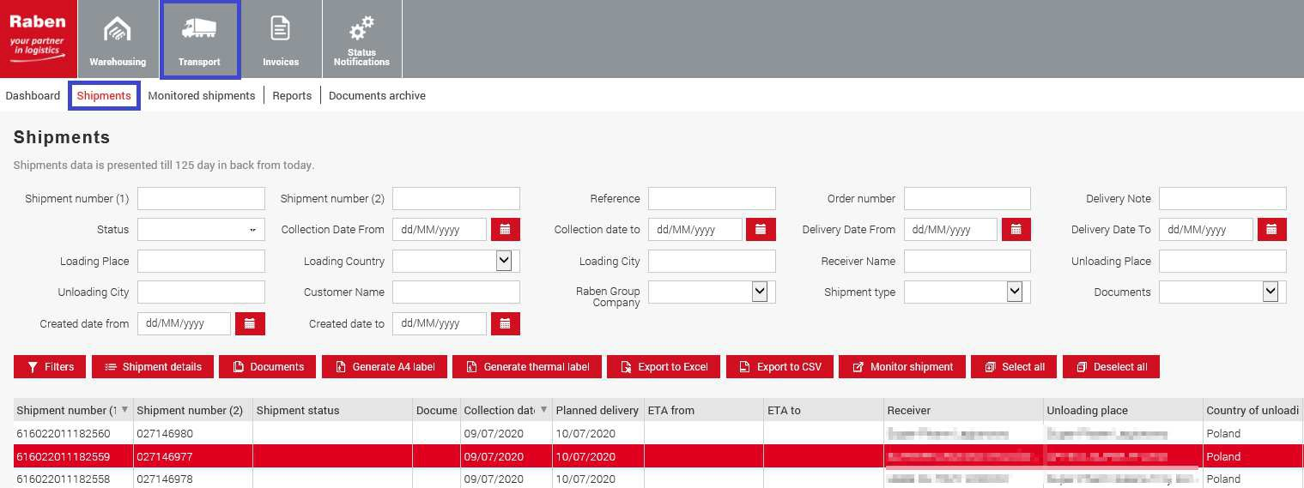
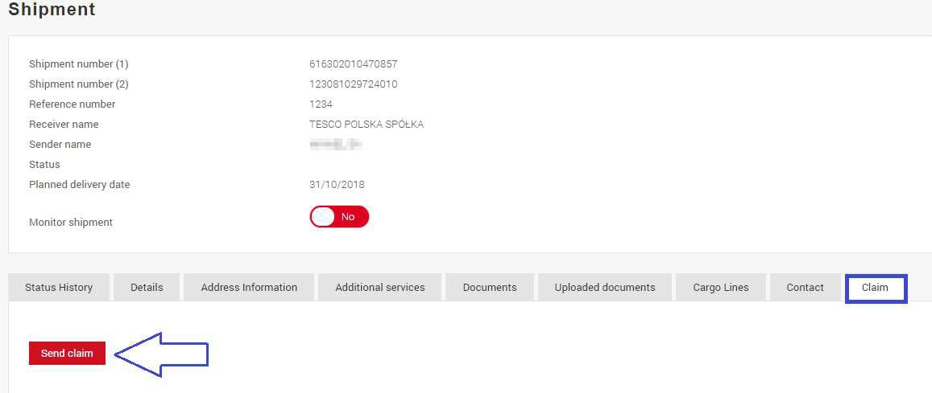
b. or use available filters on the list of available shipments in myTT.
Step 2. Go to shipment details.
Step 3. Go to the Claims tab and press Send Claim.
NOTE.
If the "Send claim" option is not visible, it means that
the logged-in user has not been authorized to file a claim.
The key user of the myraben account is entitled to grant access to this option.

Slide 7
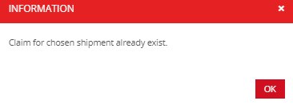
If a claim was already filed for the selected shipment - the user will be redirected to myClaim
- to claim details.
Step 4. Fill in the Claim form.
After providing all the data and attaching all necessary documents press Send -
If there are transport documents in Raben system, they will be attached to the claim - there is no need for the user who files the claim to attach them.
If some documents necessary for handling the claim are missing – the user will receive an
alert about the need to submit them.
If some documents necessary for handling the claim are missing
- the user will receive an alert about the need to submit them.
IV. Monitoring filed claims.
List of claims filed by the customer is available in the myraben.com account in myClaim application.
List of claims can be searched using available filters.

Slide 8
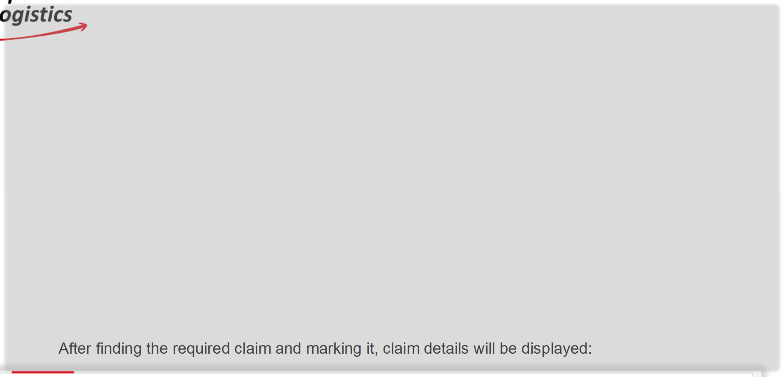
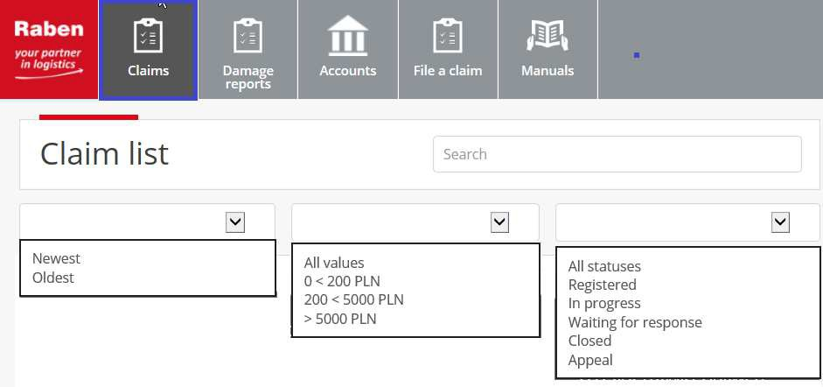
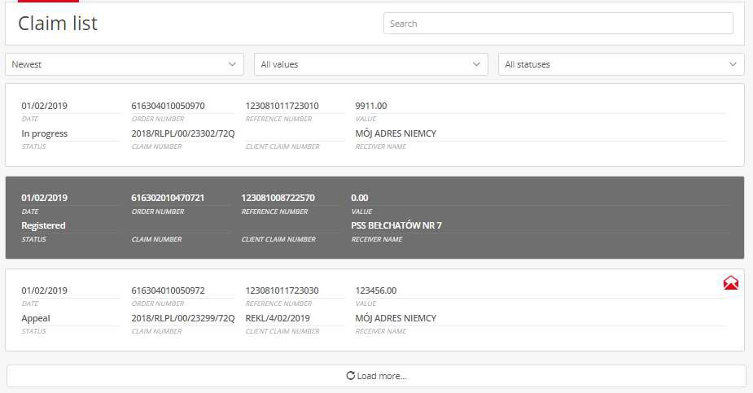
Search – quick search for the claim – simply enter claim number or shipment number or name of the consignee.
Possibility of filtering filed claims
After finding the required claim and marking it, claim details will be displayed:
Current claim status
Claim details
Open claim list

Slide 9
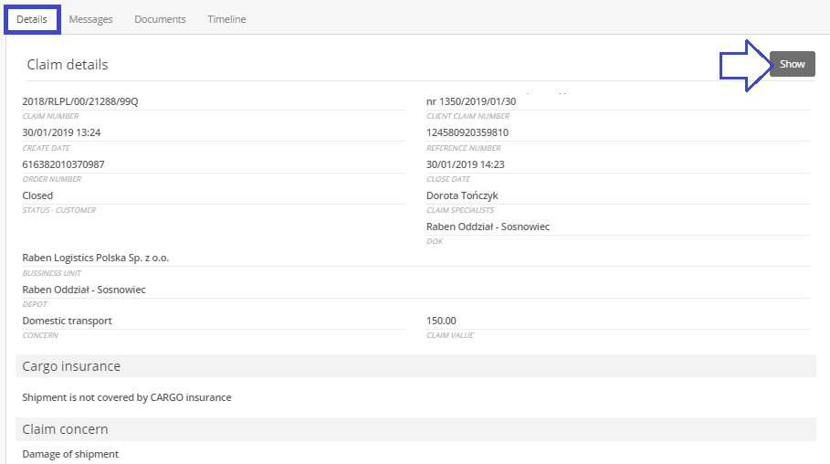
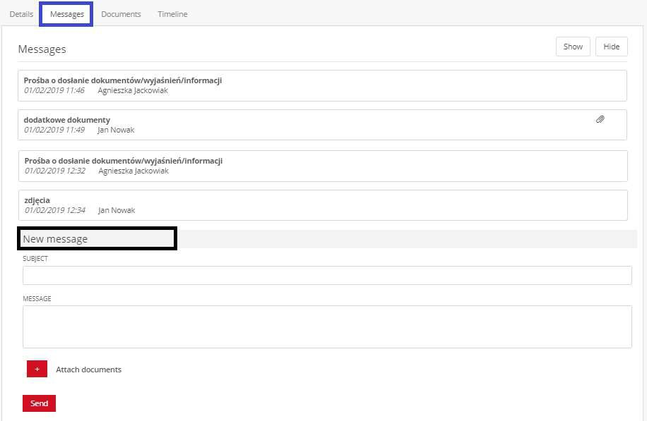
Claim details
Open window with claim details
Messages.
All correspondence regarding the claim must be added to myClaim. Thanks to this, all information about the claim will be available in one place.
If Raben requests to submit documents/additional explanation/information regarding the claim:
the user will receive an e-mail notification (to the address provided in the claim form +
in the Messages tab, next to the claim, a symbol will appear
claim status will change to Waiting for response.
Responding

Slide 10
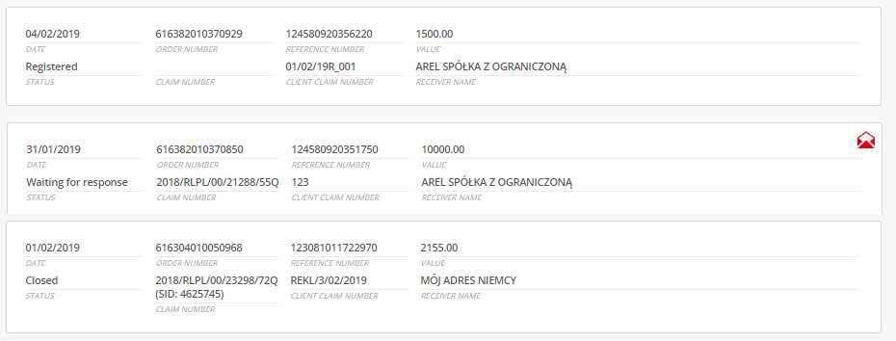
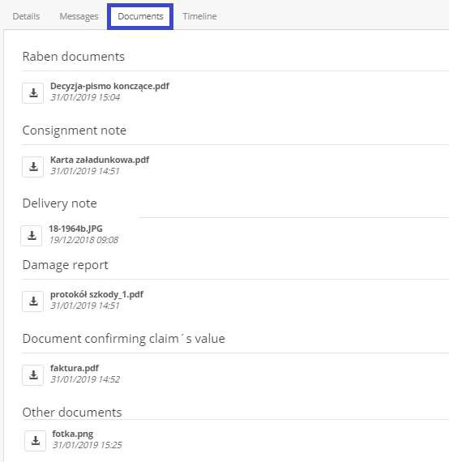
- and in myClaim, on the list of claims, near the claim in question, there will be a symbol.
You have a new message in the claim system
Claim status will change to
Waiting for response.
Documents.
Section with documents related to the claim.
Both those sent by the claimant and those provided by Raben Claims Department.
Raben document - closing the claim
Consignment note/ Delivery note
Damage report/ claim form
Documents confirming claim value
Other documents

Slide 11
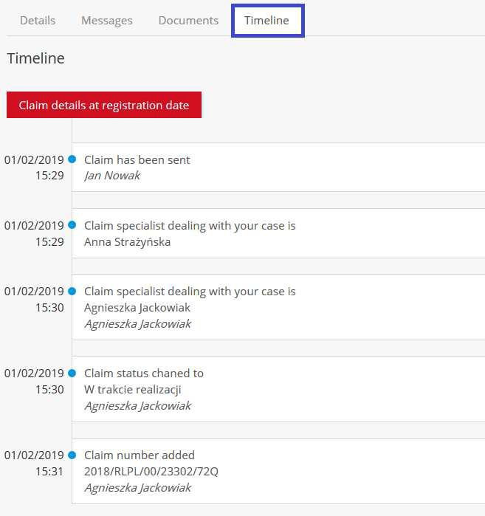
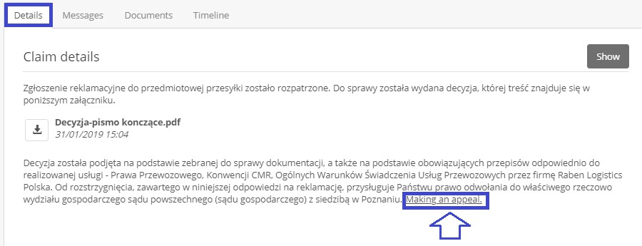
Timeline. Information about any changes made in the claim, their time and who made them.
Original claim form (PDF).
V.
Appeal.
If you disagree with the decision regarding the claim, you can file an appeal by presenting your position in writing.

Slide 12
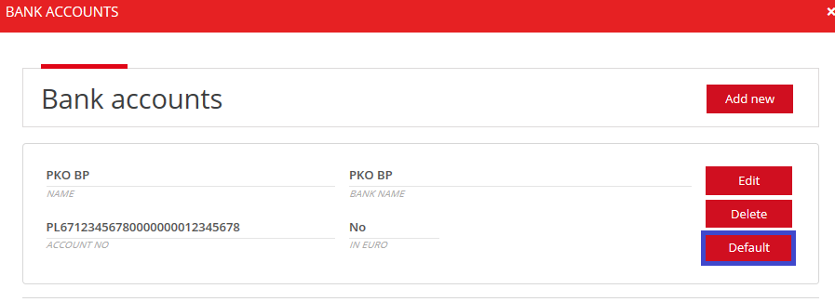
VI. Bank account settings.
Provided bank account numbers (more than one is possible) will be available for selection in the claim form of a new claim.
It is possible to select the number of one of the bank accounts as the default one for compensation payments - then in the new claim form, the field for the bank account number will already be completed with this account number (but with the possibility to change it to another account number from the list of accounts listed in this place).
VII.
Manuals.
This is where support materials for users related to the claim process will be located.

